Slide 1
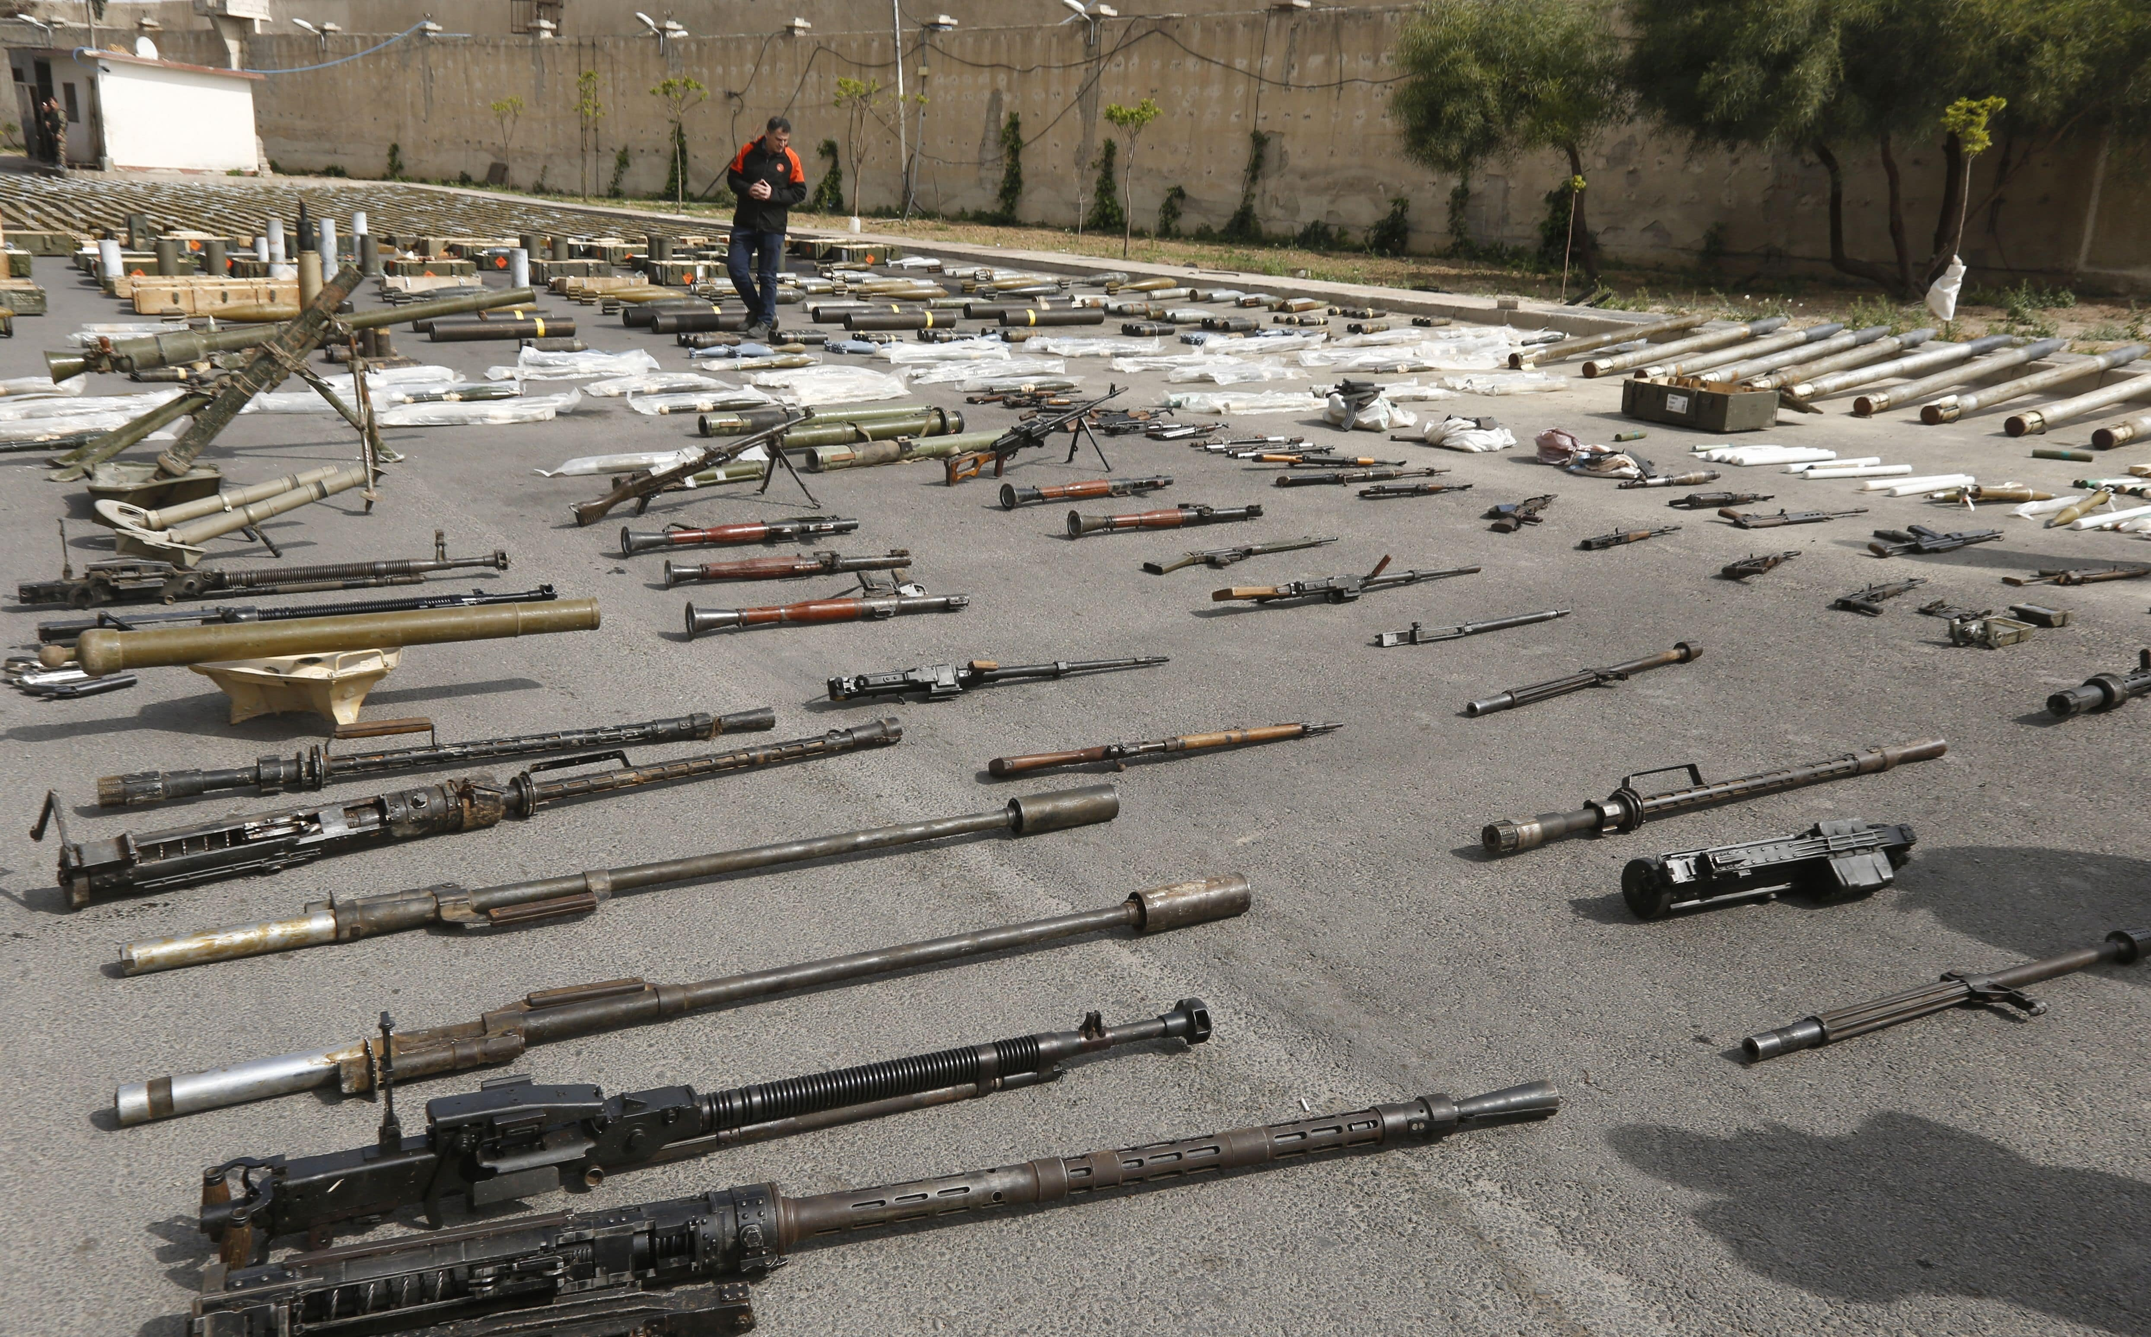
Armed Conflicts
And
Human Rights
PRESENTED BY KOUSHIK BISWAS

Slide 2
What is Armed Conflicts?
When countries or groups fight with weapons, it's called armed conflict. This often makes things unsafe and shaky.

Slide 3
Definition of Human Rights:
Human rights are the basic things everyone should have, like being treated well and having freedom. These rights are for all people, everywhere.

Slide 4
Universal Declaration of Human Rights:
In 1948, many countries agreed on the Universal Declaration of Human Rights. It's like a big list that says what rights everyone should have, no matter where they live.
treating everyone with respect (dignity)
making sure everyone is treated the same (equality)
letting people make their own choices (freedom).

Slide 5
Significance of the Topic:
Why is this important? Well, when wars happen, it can change how people live. We're going to explore how this happens.

Slide 6
Objective of the Presentation:
Today, we're going to look at why wars start, how people's rights get hurt during wars, and what happens after. It's like a big puzzle, and we'll put the pieces together.

Slide 7
Relevance in Today's World:
This matters now because there are many challenges in the world. By understanding how wars affect people, we can try to make the world fairer and more peaceful.

Slide 8


